Slide 1
Lexical Analyzer
Chapter 03

Slide 2
Definition
The main task of lexical analysis is to read input characters in the code and produce tokens.
Lexical analyzer scans the entire source code of the program. It identifies each token one by one. Scanners are usually implemented to produce tokens only when requested by a parser.

Slide 3
How lexical Analyzer Works?
Here is how recognition of tokens in compiler design works-
“Get next token” is a command which is sent from the parser to the lexical analyzer.
On receiving this command, the lexical analyzer scans the input until it finds the next token.
It returns the token to Parser.

Slide 4
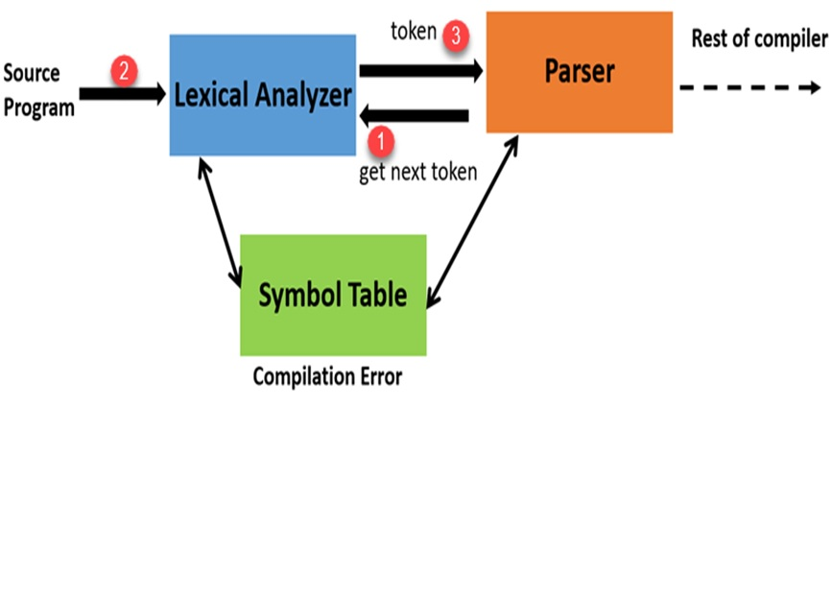
How lexical Analyzer Works?

Slide 5
Lexeme, Token, Pattern
What’s a lexeme?
A lexeme is a sequence of characters that are included in the source program according to the matching pattern of a token. It is nothing but an instance of a token.
What’s a token?
Tokens in compiler design are the sequence of characters which represents a unit of information in the source program.
What is Pattern?
A pattern is a description which is used by the token. In the case of a keyword which uses as a token, the pattern is a sequence of characters.

Slide 6
Roles of the Lexical analyzer
Helps to identify token into the symbol table
Removes white spaces and comments from the source program
Correlates error messages with the source program
Helps you to expands the macros if it is found in the source program
Read input characters from the source program

Slide 7
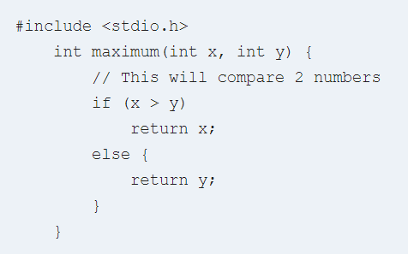
Example of Lexical Analysis, Tokens, Non-Tokens
Consider the following code that is fed to Lexical Analyzer

Slide 8
Examples of Tokens created
Lexeme | Token
int | Keyword
maximum | Identifier
( | Operator
int | Keyword
x | Identifier
, | Operator
int | Keyword
Y | Identifier
) | Operator
{ | Operator
If | Keyword

Slide 9
Examples of nontokens
Type | Examples
Comment | // This will compare 2 numbers
Pre-processor directive | #include <stdio.h>
Pre-processor directive | #define NUMS 8,9
Macro | NUMS
Whitespace | /n /b /t

Slide 10
Lexical Errors
A character sequence which is not possible to scan into any valid token is a lexical error. Important facts about the lexical error:
Lexical errors are not very common, but it should be managed by a scanner
Misspelling of identifiers, operators, keyword are considered as lexical errors
Generally, a lexical error is caused by the appearance of some illegal character, mostly at the beginning of a token.

Slide 11
Error Recovery in Lexical Analyzer
Here, are a few most common error recovery techniques:
Removes one character from the remaining input
In the panic mode, the successive characters are always ignored until we reach a well-formed token
By inserting the missing character into the remaining input
Replace a character with another character
Transpose two serial characters

Slide 12
Lexical Analyzer vs. Parser
Lexical Analyser | Parser
Scan Input program | Perform syntax analysis
Identify Tokens | Create an abstract representation of the code
Insert tokens into Symbol Table | Update symbol table entries
It generates lexical errors | It generates a parse tree of the source code

Slide 13
Why separate Lexical and Parser?
The simplicity of design: It eases the process of lexical analysis and the syntax analysis by eliminating unwanted tokens
To improve compiler efficiency: Helps you to improve compiler efficiency
Specialization: specialized techniques can be applied to improves the lexical analysis process
Portability: only the scanner requires to communicate with the outside world
Higher portability: input-device-specific peculiarities restricted to the lexer

Slide 14
Home Work
Identify the lexemes and their corresponding tokens in the following statement: printf (“Simple Interest=%f\n”, si)
Give the tokens, lexemes, and patterns for the following statement:
If (t>=y)
{
t=y -3; y=t+1;
printf(“%d%d”,t,y);
}

